Slide 1



Multimedia & Graphics
Class VI
lab 18

Slide 2

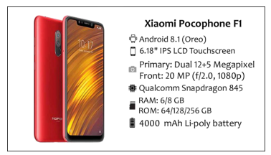
Smartphone Advertisement Poster
this is a demo advertisement poster for a smartphone. we will make a poster like this

Slide 3
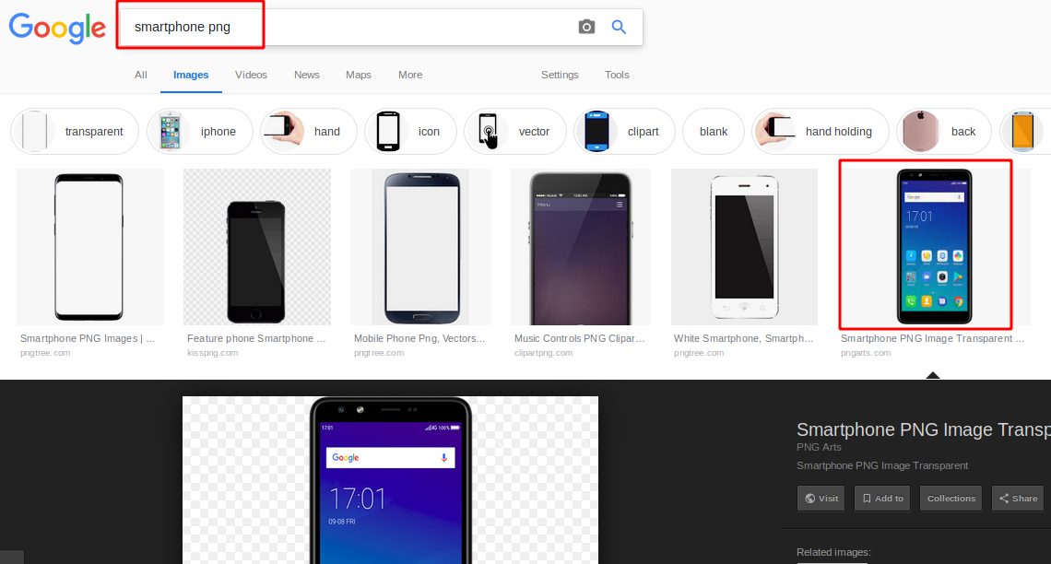
Smartphone Advertisement Poster
Search smartphone png photo from Google

Slide 4
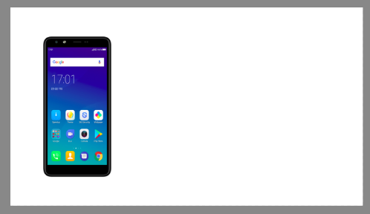
Smartphone Advertisement Poster
Paste with ( Ctrl+V ) and move the smartphone to the left

Slide 5
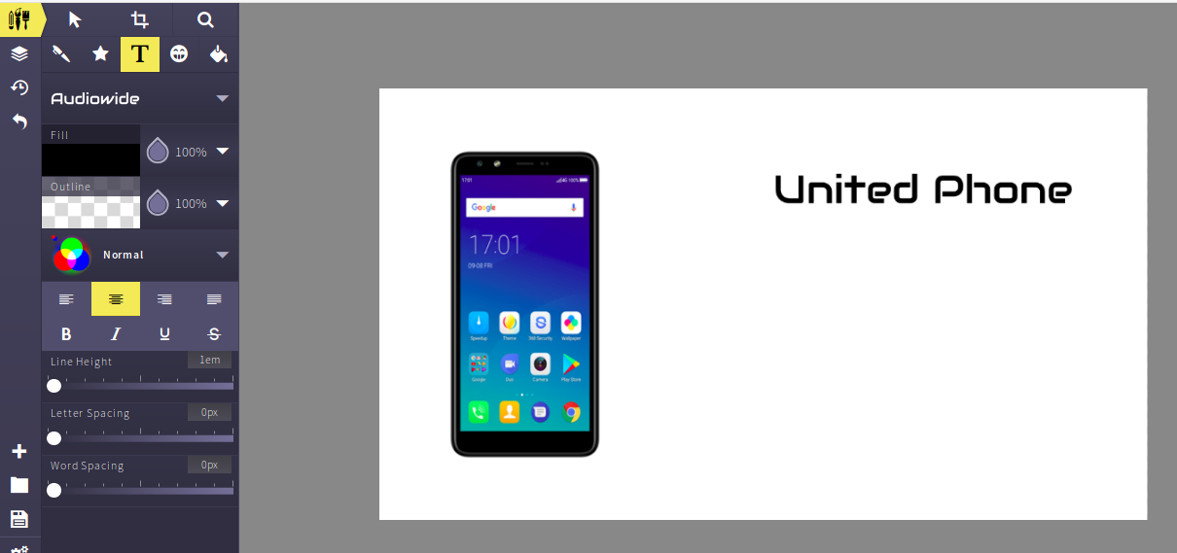
Smartphone Advertisement Poster
name your phone

Slide 6
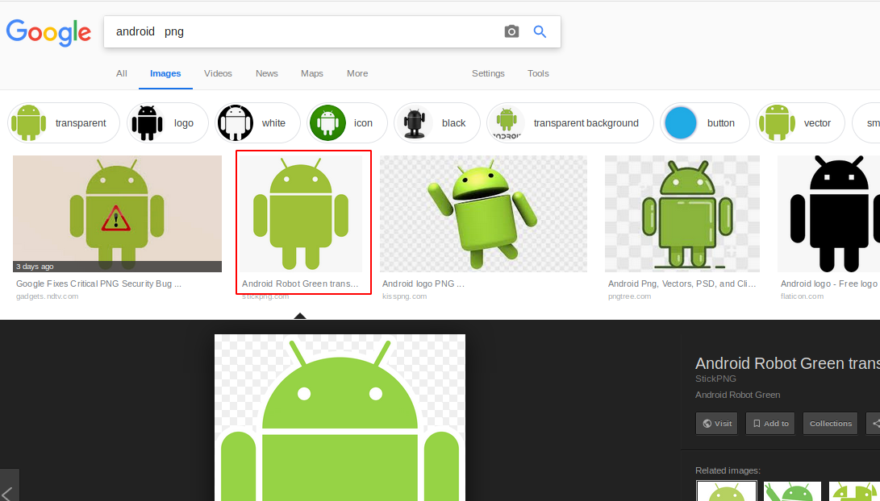
Smartphone Advertisement Poster
Search and add all the related png type images for samrtphone

Slide 7
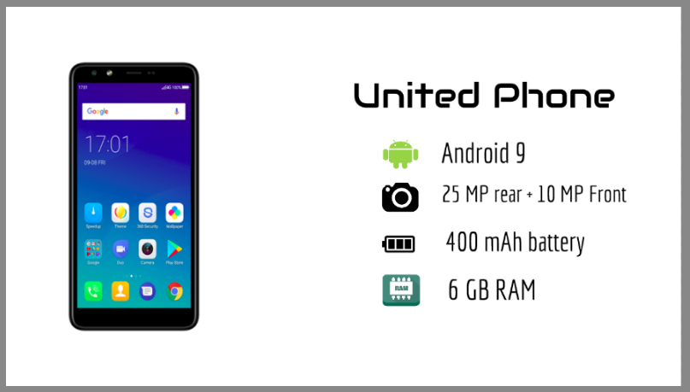
Smartphone Advertisement Poster
add related features text with images

Slide 8
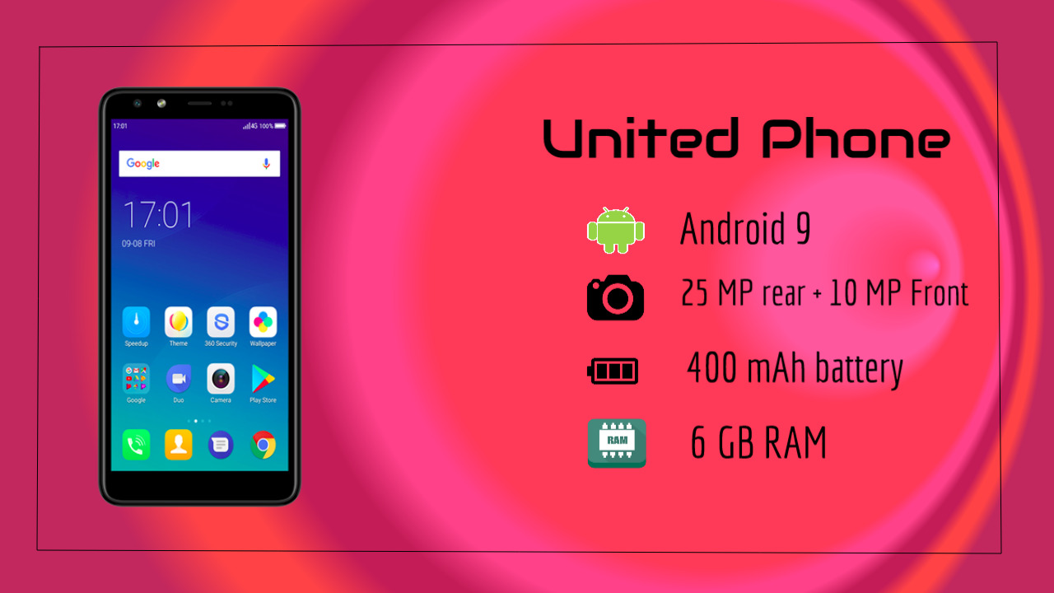
Smartphone Advertisement Poster
make a frame and change background color

Slide 9



